Slide 1
Predicting Loan defaults using logistic regression
Sonja Tilly
November 17

Slide 2
Approach and method
Project
Dataset
Data exploration
Feature engineering
Classification
Building basic logistic regression model
Optimising model parameters
Dimensionality reduction
Results
Conclusion

Slide 3
Project
Predict customers’ creditworthiness
(i.e. whether they will complete or default on a loan)
Build and test a logistic regression model
Use 70% of the data to build the model and then test the model using the remaining 30%
Notes:
The data contains rows of customers, with each column showing the features for loan applications that have been approved, together with outcomes of the loans (in the final column). The outcomes show that each customer has either defaulted or completed their loan.

Slide 4
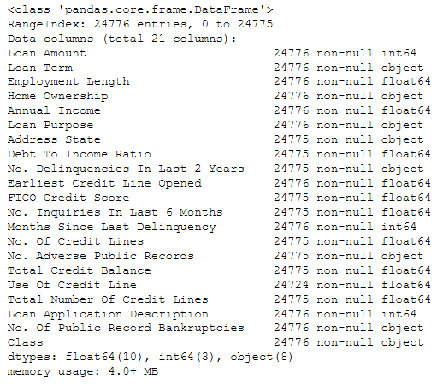
Lending Club dataset
The data contains rows of customers, with each column showing the features for loan applications that have been approved, together with outcomes of the loans (in the final column ‘Class’).
The outcomes show that each customer has either defaulted or completed their loan.

Slide 5
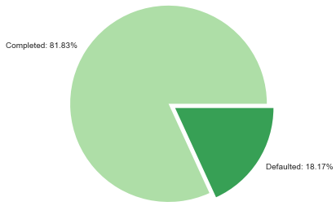
Data exploration
The dataset is unbalanced, with defaulted loans only accounting for 18.17%.
The unbalanced nature of the data will have to be considered when making predictions.

Slide 6
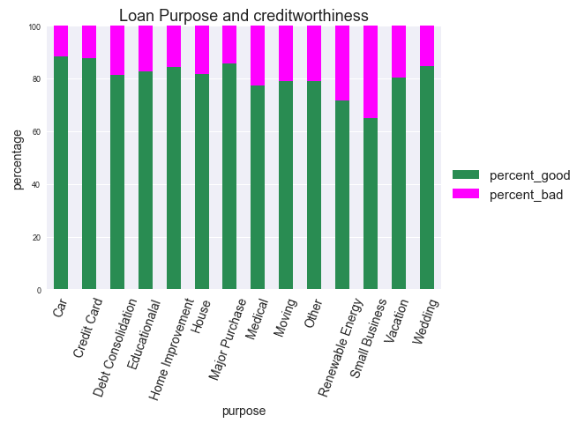
Data exploration
Loan purposes ‘Renewable Energy’ and ‘Small Business’ have the highest percentage of bad loans.

Slide 7
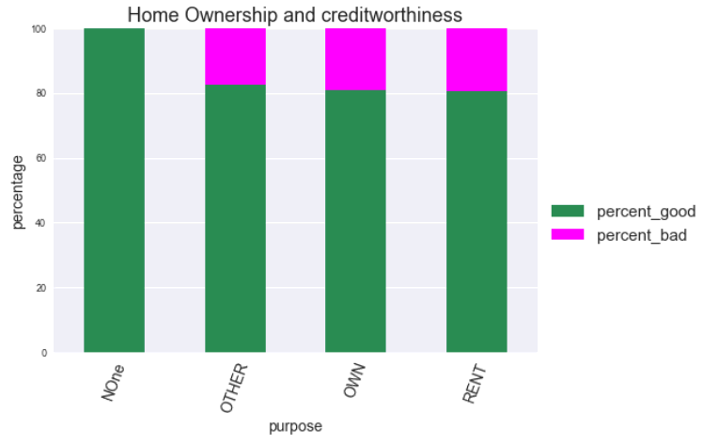
Data exploration
Category ‘None’ only contains completed loans.
Defaults in category ‘Rent’ are marginally higher than in ‘Other and ‘Own’.

Slide 8
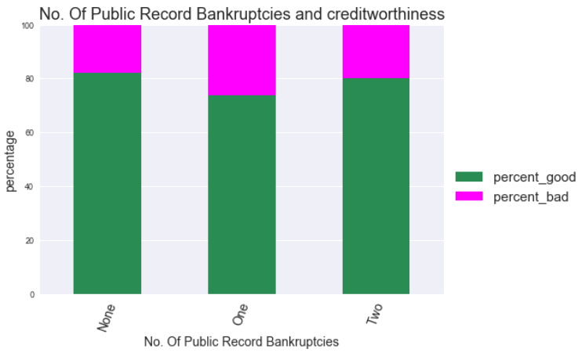
Data exploration
One public record bankruptcy has the highest percentage of bad loans.

Slide 9
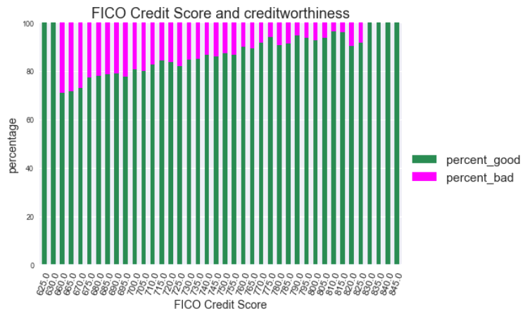
Data exploration
The lowest and the highest FICO scores do not contain bad loans, otherwise bad loans decrease with increase in score.

Slide 10
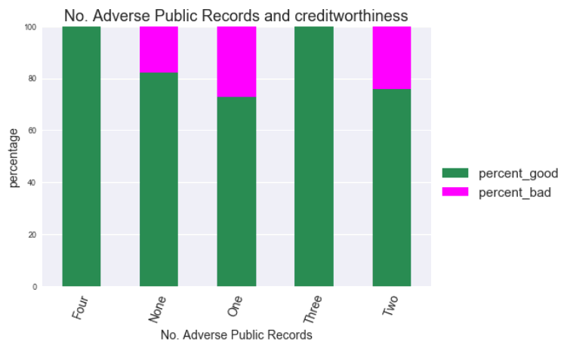
Data exploration
One adverse public record has the highest percentage of bad loans, while three only contain good loans.

Slide 11
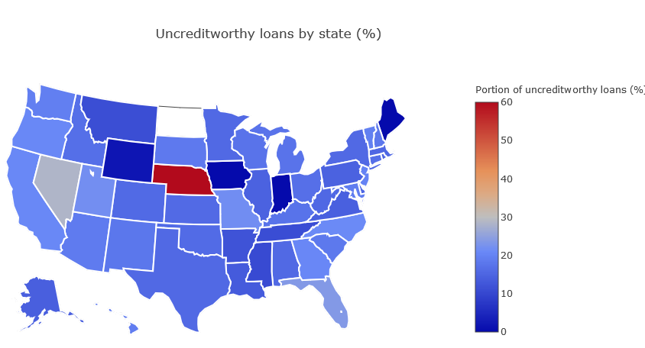
Data exploration
NE stands out as having 60% of bad loans, or 5 bad loans in absolute numbers.
NV has 28.43% of bad loans, or 306 bad loans in absolute numbers.

Slide 12
Data exploration: initial insights
Relationships between predictor and target variable are not always linear.
Observatons of features ‘FICO Credit Score’ and ‘Address State’ can be grouped in order to increase predictive power.

Slide 13
Feature engineering
convert 'Class' feature (=target) into numerical values
Assign ‘0’ to ‘creditworthy’
Assign ‘1’ to ‘uncreditworthy’

Slide 14
Feature engineering
summarise address states into geographic regions:
East_Coast: 7731 obversations
South: 6885 obversations
West_Coast: 4485 obversations
Middle: 3461 obversations
North: 2213 observations
summarise FICO scores into categories
Very Good: 15950 obversations
Exceptional: 5208 obversations
Good: 3337 obversations

Slide 15
Feature engineering
create dummy variables for categorical features
'Loan Term',
'Home Ownership',
'Loan Purpose',
'FICO Credit Score',
'Address State'

Slide 16
Feature engineering
encode remaining columns containing object data types
'No. Delinquencies In Last 2 Years‘
'No. Adverse Public Records‘
'No. Of Public Records
The above columns contain strings (e.g. one, two, three, …) describing numbers from 0 to 9
Change strings into numerical format (e.g. 1, 2, 3, …)

Slide 17
Feature engineering
drop redundant feature
Drop ‘Class’ feature
deal with nan values
Replace ‘nan’ with median values for each feature

Slide 18
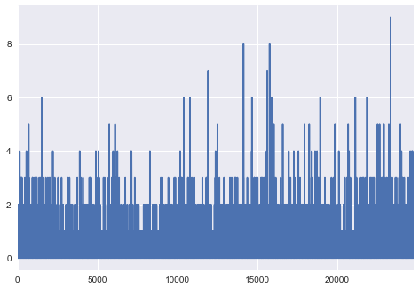
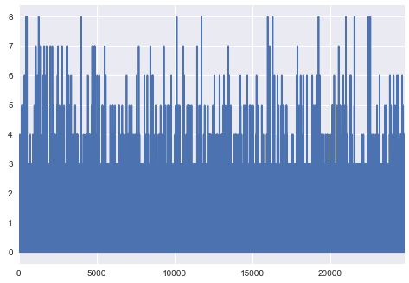
Feature engineering
Deal with outliers
No. Delinquencies In Last 2 Years:
Take out values above 4
No. Inquiries In Last 6 Months:
Take out values above 7

Slide 19
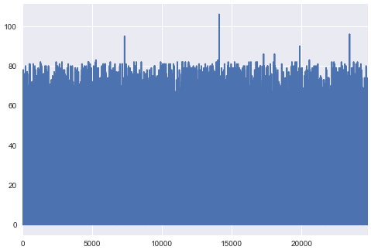
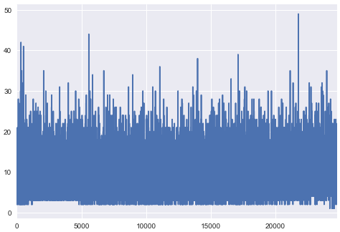
Feature engineering
Months Since Last Delinquency:
Take out values above 85
No. Of Credit Lines:
Take out values above 30

Slide 20
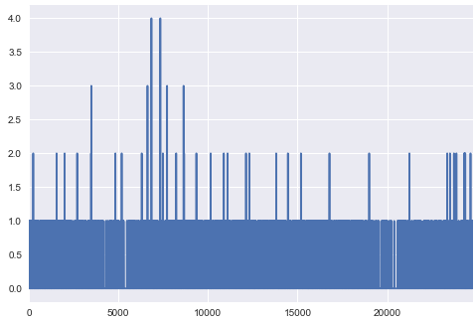
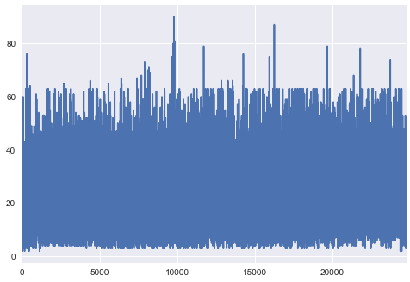
Feature engineering
No. Adverse Public Records:
Take out values above 1
Total Number Of Credit Lines:
Take out values above 65

Slide 21
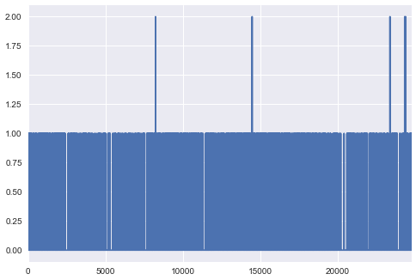
Feature engineering
No. Of Public Record Bankruptcies:
Take out values above 1

Slide 22
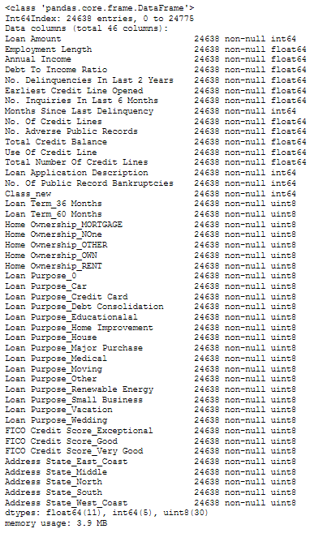
Feature engineering
The dataset has been reduced to 24638 entries from 24776 observations
The dataset now contains 46 feature columns

Slide 23
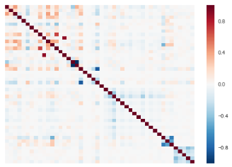
Feature engineering
Correlation matrix
The correlation matrix indicates that there are some features with minimal correlation, which has to be addressed.

Slide 24
Classification
Define predictor variables (X) and target variable (y)
y = ‘Class_new column containing ‘0’ for completed and ‘1’ for defaulted loan
X = transformed features excluding y
Implement train test split on X and y
70% train, 30% test
Stratify target y as data may not be normally distributed

Slide 25
Classification: Evaluation Metric
AUC (‘area under the curve’) score
TPR (also called Recall or Sensitivity) = sum total positives/sum of condition positive = TP/(TP+FN)
FPR (also called Fall-out) = sum of false positives/sum of condition negative = FP/(FP+TN)
To combine the FPR and the TPR into one single metric, the two metrics are computed with using many different thresholds (for example 0.00;0.01,0.02,…,1.00 0.00;0.01,0.02,…,1.00 ) for the logistic regression.
The ROC curve is created by plotting the true positive rate (TPR) against the false positive rate (FPR) at various threshold settings.
From www.wikipedia.com
Notes:
The AUC score equals the probability that a randomly chosen positive example ranks above (is deemed to have a higher probability of being positive than) a randomly chosen negative example.

Slide 26
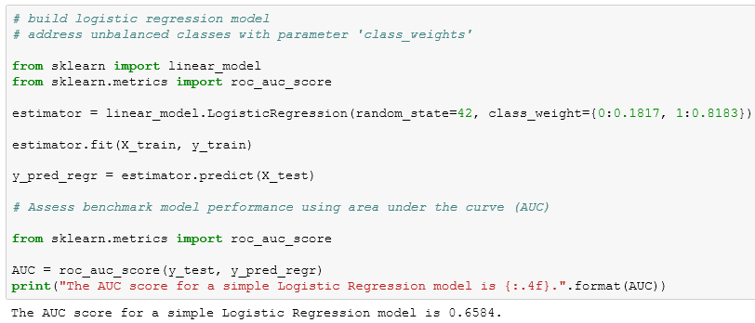
Classification
Build logistic regression model
Add class weights to account for unbalanced classes
Initial AUC score:
0.6584

Slide 27
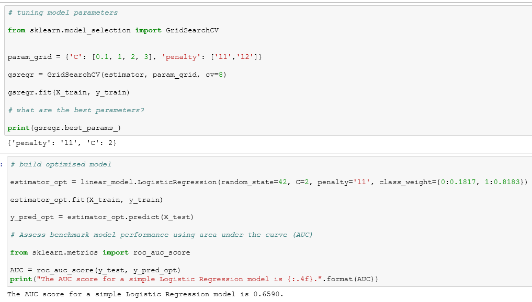
Classification
Optimise logistic regression model
Use GridSearchCV to find best model parameters
The optimised model generates an AUC of 0.6590

Slide 28
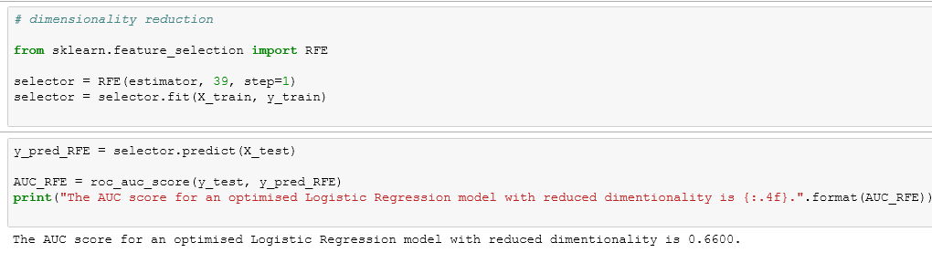
Classification
Identifying the optimal subset of features through recursive feature elimination using a backward approach
The optimal number of features is 39
Using the model with reduced features, the score is 0.6600

Slide 29
Results
The final model delivered an AUC score of 0.6600.
This can be interpreted as the probability that a randomly chosen positive example ranks is deemed to have a higher probability of being positive than a randomly chosen negative example.
Parameter tuning and feature elimination improved the score.

Slide 30
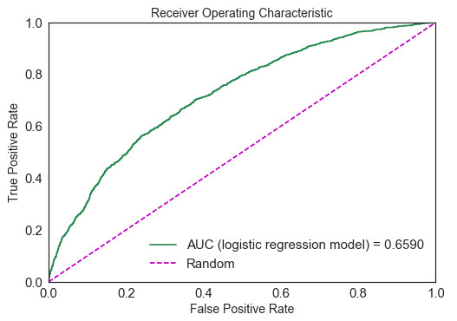
Results: Receiver Operating Characteristic
Notes:
The dataset is unbalanced, with bad loans accounting for only a small portion of the total number of loans. Due to this class imbalance, model accuracy will be assessed the Area Under the Curve (AUC).
A receiver operating characteristic curve or ROC curve is a graph plotting the true positive rate against the false positive rate at different thresholds. It indicates how well a classifier can discriminate positive and negative instances and identify the best threshold for discriminating them. The curve is created by plotting the true positive rate (TPR) against the false positive rate (FPR) at various threshold settings.
TPR (also called Recall or Sensitivity) = sum total positives/sum of condition positive
FPR (also called Fall-out) = sum of false positives/sum of condition negative
The area under the curve (AUC) is equal to the probability that a classifier will rank a randomly chosen positive instance higher than a randomly chosen negative one.

Slide 31
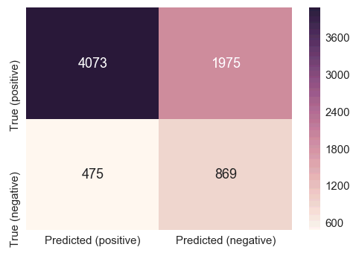
Results: Confusion Matrix
fsfs
Notes:
What is a confusion matrix?
Visualization of the performance of an algorithm
Each row of the matrix represents the instances in a actual class while each column represents the instances in an predicted class

Slide 32
Conclusion
The model outperforms random guessing in predicting loan defaults.
How does this add value for the client?
Being able to predict loan defaults can help to adapt lending practices, minimise losses and thus, improve profitability.

Slide 33
Conclusion
Limitations
Relationships between predictor variables and target are not necessarily linear, which may impact performance
The amount of features and observations was not very large
Recommendations
Get more data
Build model using XG Boost, as this algorithm tends to perform well with non-linear data

Slide 34
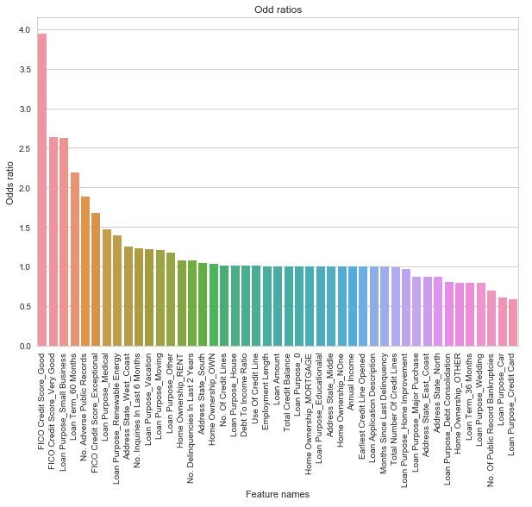
Appendix: Coefficient Odds Ratios
Odd ratios
How to interpret the odds ratio:
A score over 1 indicates a positive relationship with the target variable, a score below 1 a negative one.
Odds of success = ratio of probability of success / probability of failure
If the probability of success is 50/50, the odds of success are 1/1 = 1
For example, FICO Credit Score_Good has an odd ratio of 3.948234. This means than the odds for a defaulted loan are 295% higher than the odds for completed one.

